Slide 1

CSE 317 July 2022
Artificial Intelligence
Dr. M A Nayeem
Assistant Professor
Dept. of CSE, BUET

Slide 2
Language

Slide 3
Natural Language Processing

Slide 4
What is NLP
Wiki: is a field of computer science, artificial intelligence, and computational linguistics concerned with the interactions between computers and human (natural) languages.

Slide 5
Go beyond keyword matching
Identify the structure and meaning of words, sentences, texts and conversations
Deep understanding of language

Slide 6
Natural Language Processing
automatic summarization
information extraction
language identification
machine translation
named entity recognition
speech recognition
text classification
word sense disambiguation
...

Slide 7
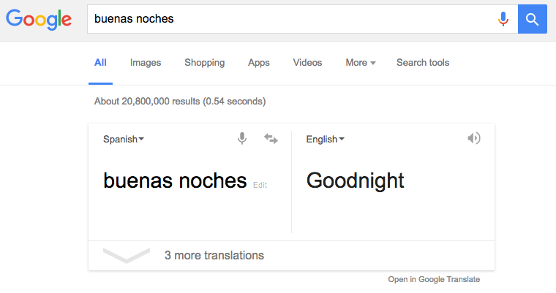
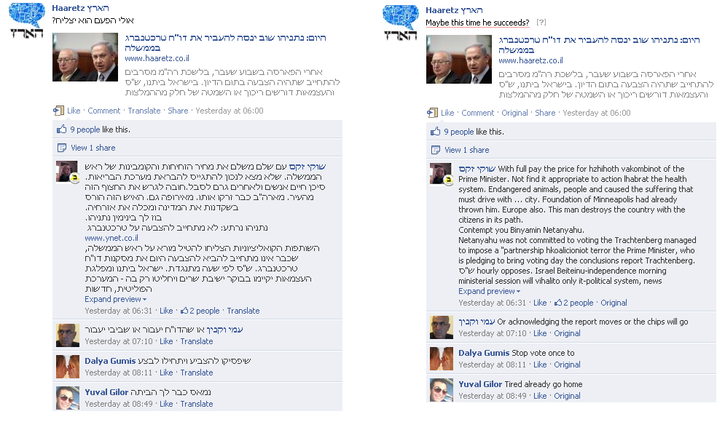
Machine translation

Slide 8
Sentiment Analysis

Slide 9
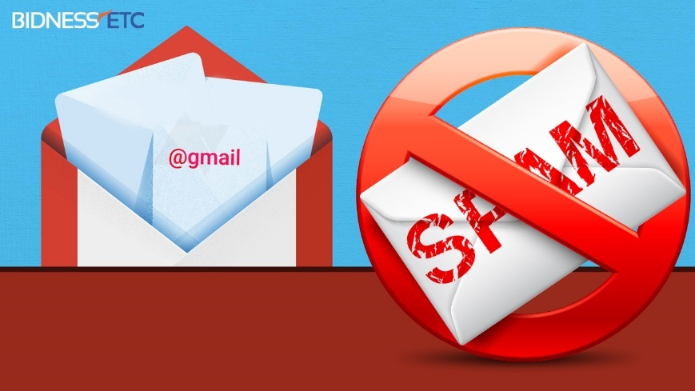
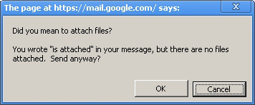
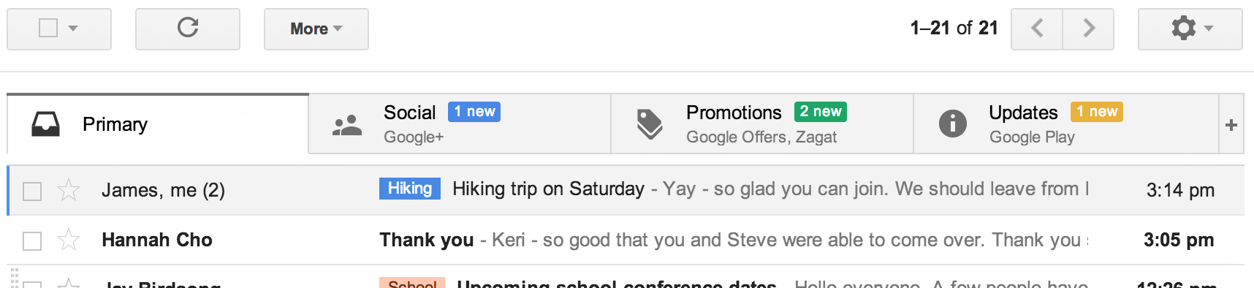
Text Classification
www.wired.com

Slide 10
Question Answering

Slide 11
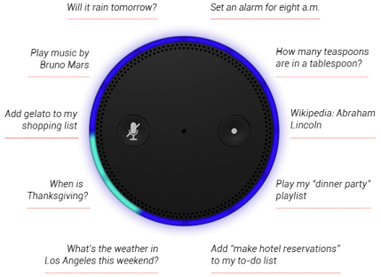
NL instruction

Slide 12
Information Extraction
Unstructured text to database entries

Slide 13
Co-reference Resolution
Christopher Robin is alive and well. He is the same person that you read about in the book, Winnie the Pooh. As a boy, Chris lived in a pretty home called Cotchfield Farm. When Chris was three years old, his father wrote a poem about him. The poem was printed in a magazine for others to read. Mr. Robin then wrote a book

Slide 14
Co-reference Resolution
Christopher Robin is alive and well. He is the same person that you read about in the book, Winnie the Pooh. As a boy, Chris lived in a pretty home called Cotchfield Farm. When Chris was three years old, his father wrote a poem about him. The poem was printed in a magazine for others to read. Mr. Robin then wrote a book

Slide 15
Co-reference Resolution
Christopher Robin is alive and well. He is the same person that you read about in the book, Winnie the Pooh. As a boy, Chris lived in a pretty home called Cotchfield Farm. When Chris was three years old, his father wrote a poem about him. The poem was printed in a magazine for others to read. Mr. Robin then wrote a book

Slide 16
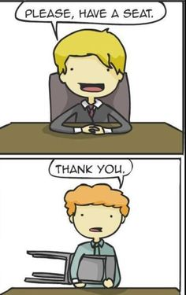
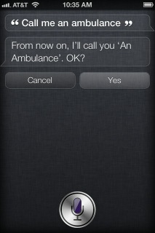
Challenges – ambiguity
Word sense / meaning ambiguity

Slide 17
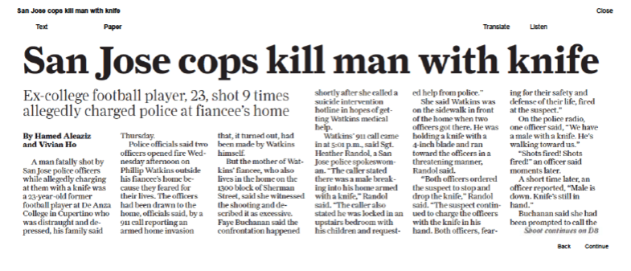
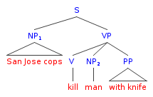
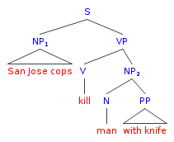
Challenges – ambiguity
Word sense / meaning ambiguity

Slide 18

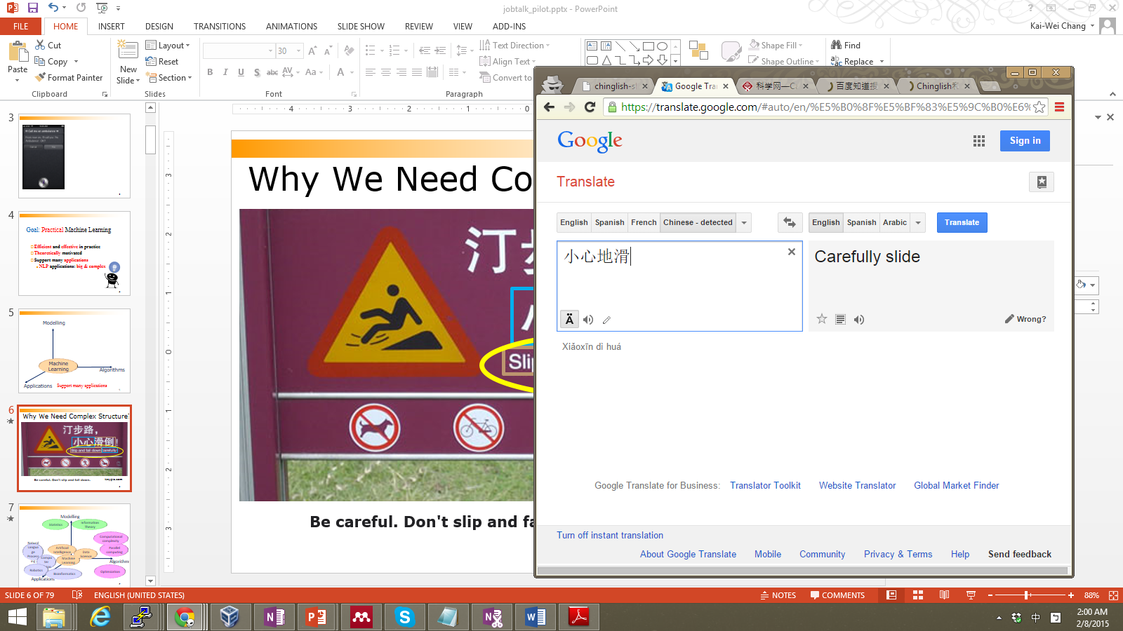
Challenges-language is compositional
Carefully Slide

Slide 19
Challenges-language is compositional
小心:
Carefully
Careful
Take Care
Caution
地滑:
Slide
Landslip
Wet Floor
Smooth

Slide 20
Syntax

Slide 21
"Just before nine o'clock Sherlock Holmes stepped briskly into the room."

Slide 22
"Just before Sherlock Holmes nine o'clock stepped briskly the room."

Slide 23
"I saw the man on the mountain with a telescope."

Slide 24
Semantics

Slide 25
"Just before nine o'clock Sherlock Holmes stepped briskly into the room."

Slide 26
"Sherlock Holmes stepped briskly into the room just before nine o'clock."

Slide 27
"A few minutes before nine, Sherlock Holmes walked quickly into the room."

Slide 28
"Colorless green ideas sleep furiously."

Slide 29
Natural Language Processing

Slide 30
Syntax

Slide 31
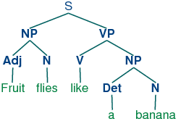
Syntactic Parsing
Fruit flies like a banana

Slide 32
Syntactic structure => meaning

Slide 33
formal grammar
a system of rules for generating sentences in a language

Slide 34
Context-Free Grammar

Slide 35
N
V
D
N
V
she
saw
the
city

Slide 36
N
V
D
N
V
she
saw
the
city

Slide 37
N → she | city | car | Harry | ...
D → the | a | an | ...
V → saw | ate | walked | ... P → to | on | over | ...
ADJ → blue | busy | old | ...

Slide 38
NP → N | D N

Slide 39
NP
NP → N | D N
N
she

Slide 40
NP → N | D N
NP
D
N
the
city

Slide 41
VP → V | V NP

Slide 42
VP
VP → V | V NP
V
walked

Slide 43
VP
V
NP
V
VP → V | V NP
D
N
saw
the
city

Slide 44
S → NP VP

Slide 45
S
NP
VP
S → NP VP
NP
V
V
N
D
N
she
saw
the
city

Slide 46
nltk

Slide 47
n-gram
a contiguous sequence of n items from a sample of text

Slide 48
character n-gram
a contiguous sequence of n characters from a sample of text

Slide 49
word n-gram
a contiguous sequence of n words from a sample of text

Slide 50
unigram
a contiguous sequence of 1 item from a sample of text

Slide 51
bigram
a contiguous sequence of 2 items from a sample of text

Slide 52
trigrams
a contiguous sequence of 3 items from a sample of text

Slide 53
"How often have I said to you that when you have eliminated the impossible whatever remains, however improbable, must be the truth?"

Slide 54
"How often have I said to you that when you have eliminated the impossible whatever remains, however improbable, must be the truth?"

Slide 55
"How often have I said to you that when you have eliminated the impossible whatever remains, however improbable, must be the truth?"

Slide 56
"How often have I said to you that when you have eliminated the impossible whatever remains, however improbable, must be the truth?"

Slide 57
"How often have I said to you that when you have eliminated the impossible whatever remains, however improbable, must be the truth?"

Slide 58
"How often have I said to you that when you have eliminated the impossible whatever remains, however improbable, must be the truth?"

Slide 59
"How often have I said to you that when you have eliminated the impossible whatever remains, however improbable, must be the truth?"

Slide 60
tokenization
the task of splitting a sequence of characters into pieces (tokens)

Slide 61
word tokenization
the task of splitting a sequence of characters into words

Slide 62
sentence tokenization
the task of splitting a sequence of characters into sentences

Slide 63
"Whatever remains, however improbable, must be the truth."

Slide 64
"Whatever remains, however improbable, must be the truth."
["Whatever", "remains,", "however",
"improbable,", "must", "be", "the", "truth."]

Slide 65
"Whatever remains, however improbable, must be the truth."
["Whatever", "remains,", "however",
"improbable,", "must", "be", "the", "truth."]

Slide 66
"Whatever remains, however improbable, must be the truth."
["Whatever", "remains", "however",
"improbable", "must", "be", "the", "truth"]

Slide 67
"Just before nine o'clock Sherlock Holmes stepped briskly into the room."

Slide 68
"Just before nine o'clock Sherlock Holmes stepped briskly into the room."

Slide 69
"He was dressed in a sombre yet rich style, in black frock-coat, shining hat, neat brown gaiters, and well-cut pearl- grey trousers."

Slide 70
"He was dressed in a sombre yet rich style, in black frock-coat, shining hat, neat brown gaiters, and well-cut pearl- grey trousers."

Slide 73
"I cannot waste time over this sort of fantastic talk, Sherlock. If you can catch the man, catch him, and let me know when you have done it."

Slide 74
"I cannot waste time over this sort of fantastic talk, Sherlock. If you can catch the man, catch him, and let me know when you have done it."

Slide 75
"I cannot waste time over this sort of fantastic talk, Sherlock. If you can catch the man, catch him, and let me know when you have done it."

Slide 76
"I cannot waste time over this sort of fantastic talk, Sherlock. If you can catch the man, catch him, and let me know when you have done it."

Slide 77
"I cannot waste time over this sort of fantastic talk, Mr. Holmes. If you can catch the man, catch him, and let me know when you have done it."

Slide 78
"I cannot waste time over this sort of fantastic talk, Mr. Holmes. If you can catch the man, catch him, and let me know when you have done it."

Slide 79
"I cannot waste time over this sort of fantastic talk, Mr. Holmes. If you can catch the man, catch him, and let me know when you have done it."

Slide 80
"I cannot waste time over this sort of fantastic talk, Mr. Holmes. If you can catch the man, catch him, and let me know when you have done it."

Slide 81
"I cannot waste time over this sort of fantastic talk, Mr. Holmes. If you can catch the man, catch him, and let me know when you have done it."

Slide 82
"I cannot waste time over this sort of fantastic talk, Mr. Holmes," he said. "If you can catch the man, catch him, and let me know when you have done it."

Slide 83
Markov Models

Slide 85
Text Categorization

Slide 86

Spam
Inbox

Slide 87


Sentiment Analysis

Slide 88
"My grandson loved it! So much fun!"
"Product broke after a few days."
"One of the best games I've played in a long time."
"Kind of cheap and flimsy, not worth it."

Slide 89
"My grandson loved it! So much fun!"
"Product broke after a few days."
"One of the best games I've played in a long time."
"Kind of cheap and flimsy, not worth it."

Slide 90
"My grandson loved it! So much fun!"
"Product broke after a few days."
"One of the best games I've played in a long time."
"Kind of cheap and flimsy, not worth it."

Slide 91
bag-of-words model
model that represents text as an unordered collection of words

Slide 92
Naive Bayes

Slide 93
Bayes' Rule
_{P(b | a) =} P(a | b)
P(b)
P(a)

Slide 94
P(Positive)
P(Negative)

Slide 95
P( 😀)
P( 🙁)

Slide 96
"My grandson loved it!"

Slide 97
P( 😀)

Slide 98
P(😀 | "my grandson loved it")

Slide 99
P(😀 | "my", "grandson", "loved", "it")

Slide 100
P(😀 | "my", "grandson", "loved", "it")

Slide 101
P(😀 | "my", "grandson", "loved", "it")
equal to
P("my", "grandson", "loved", "it" | 😀) P(😀)
P("my", "grandson", "loved", "it")

Slide 102
P(😀 | "my", "grandson", "loved", "it")
proportional to
P("my", "grandson", "loved", "it" | 😀) P(😀)

Slide 103
P(😀 | "my", "grandson", "loved", "it")
naively proportional to
P(😀)P("my" | 😀)P("grandson" | 😀)
P("loved" | 😀) P("it" | 😀)

Slide 104
number of positive samples
P(😀)
=
number of total samples

Slide 105
number of positive samples with "loved"
=
P("loved" | 😀)
number of positive samples

Slide 106
P(😀)P("my" | 😀)P("grandson" | 😀)
P("loved" | 😀) P("it" | 😀)
😀 | 🙁
0.49 | 0.51
 | 😀 | 🙁
my | 0.30 | 0.20
grandson | 0.01 | 0.02
loved | 0.32 | 0.08
it | 0.30 | 0.40

Slide 107
P(😀)P("my" | 😀)P("grandson" | 😀)
P("loved" | 😀) P("it" | 😀)
😀 | 🙁
0.49 | 0.51
 | 😀 | 🙁
my | 0.30 | 0.20
grandson | 0.01 | 0.02
loved | 0.32 | 0.08
it | 0.30 | 0.40

Slide 108
P(😀)P("my" | 😀)P("grandson" | 😀)
P("loved" | 😀) P("it" | 😀)
😀 | 🙁
0.49 | 0.51
 | 😀 | 🙁
my | 0.30 | 0.20
grandson | 0.01 | 0.02
loved | 0.32 | 0.08
it | 0.30 | 0.40
😀 0.00014112

Slide 109
P(😀)P("my" | 😀)P("grandson" | 😀)
P("loved" | 😀) P("it" | 😀)
😀 | 🙁
0.49 | 0.51
 | 😀 | 🙁
my | 0.30 | 0.20
grandson | 0.01 | 0.02
loved | 0.32 | 0.08
it | 0.30 | 0.40
😀 0.00014112

Slide 110
P(😀)P("my" | 😀)P("grandson" | 😀)
P("loved" | 😀) P("it" | 😀)
😀 | 🙁
0.49 | 0.51
 | 😀 | 🙁
my | 0.30 | 0.20
grandson | 0.01 | 0.02
loved | 0.32 | 0.08
it | 0.30 | 0.40
😀 0.00014112

Slide 111
P(🙁)P("my" | 🙁)P("grandson" | 🙁)
P("loved" | 🙁) P("it" | 🙁)
😀 | 🙁
0.49 | 0.51
 | 😀 | 🙁
my | 0.30 | 0.20
grandson | 0.01 | 0.02
loved | 0.32 | 0.08
it | 0.30 | 0.40
😀 0.00014112

Slide 112
P(🙁)P("my" | 🙁)P("grandson" | 🙁)
P("loved" | 🙁) P("it" | 🙁)
😀 | 🙁
0.49 | 0.51
 | 😀 | 🙁
my | 0.30 | 0.20
grandson | 0.01 | 0.02
loved | 0.32 | 0.08
it | 0.30 | 0.40
😀 0.00014112
🙁 0.00006528

Slide 113
P(🙁)P("my" | 🙁)P("grandson" | 🙁)
P("loved" | 🙁) P("it" | 🙁)
😀 | 🙁
0.49 | 0.51
 | 😀 | 🙁
my | 0.30 | 0.20
grandson | 0.01 | 0.02
loved | 0.32 | 0.08
it | 0.30 | 0.40
😀 0.00014112
🙁 0.00006528

Slide 114
P(🙁)P("my" | 🙁)P("grandson" | 🙁)
P("loved" | 🙁) P("it" | 🙁)
😀 | 🙁
0.49 | 0.51
 | 😀 | 🙁
my | 0.30 | 0.20
grandson | 0.01 | 0.02
loved | 0.32 | 0.08
it | 0.30 | 0.40
😀 0.6837
🙁 0.3163

Slide 115
P(🙁)P("my" | 🙁)P("grandson" | 🙁)
P("loved" | 🙁) P("it" | 🙁)
😀 | 🙁
0.49 | 0.51
 | 😀 | 🙁
my | 0.30 | 0.20
grandson | 0.01 | 0.02
loved | 0.32 | 0.08
it | 0.30 | 0.40

Slide 116
P(🙁)P("my" | 🙁)P("grandson" | 🙁)
P("loved" | 🙁) P("it" | 🙁)
😀 | 🙁
0.49 | 0.51
 | 😀 | 🙁
my | 0.30 | 0.20
grandson | 0.00 | 0.02
loved | 0.32 | 0.08
it | 0.30 | 0.40

Slide 117
P(🙁)P("my" | 🙁)P("grandson" | 🙁)
P("loved" | 🙁) P("it" | 🙁)
😀 | 🙁
0.49 | 0.51
 | 😀 | 🙁
my | 0.30 | 0.20
grandson | 0.00 | 0.02
loved | 0.32 | 0.08
it | 0.30 | 0.40
😀 0.00000000
🙁 0.00006528

Slide 118
additive smoothing
adding a value α to each value in our distribution to smooth the data

Slide 119
Laplace smoothing
adding 1 to each value in our distribution: pretending we've seen each value one more time than we actually have

Slide 120
information retrieval
the task of finding relevant documents in response to a user query

Slide 121
topic modeling
models for discovering the topics for a set of documents

Slide 122
term frequency
number of times a term appears in a document

Slide 123
function words
words that have little meaning on their own, but are used to grammatically connect other words

Slide 124
function words
am, by, do, is, which, with, yet, ...

Slide 125
content words
words that carry meaning independently

Slide 126
content words
algorithm, category, computer, ...

Slide 127
inverse document frequency
measure of how common or rare a word is across documents

Slide 128
inverse document frequency
_{log} TotalDocuments NumDocumentsContaining(word)

Slide 129
tf-idf
ranking of what words are important in a document by multiplying term frequency (TF) by inverse document frequency (IDF)

Slide 130
Semantics

Slide 131
information extraction
the task of extracting knowledge from documents

Slide 132
"When Facebook was founded in 2004, it began with a seemingly innocuous mission: to connect friends. Some seven years and 800 million users later, the social network has taken over most aspects of our personal and professional lives, and is fast becoming the dominant communication platform of the future."
Harvard Business Review, 2011
"Remember, back when Amazon was founded in 1994, most people thought his idea to sell books over this thing called the internet was crazy. A lot of people had never even hard of the internet."
Business Insider, 2018

Slide 133
"When Facebook was founded in 2004, it began with a seemingly innocuous mission: to connect friends. Some seven years and 800 million users later, the social network has taken over most aspects of our personal and professional lives, and is fast becoming the dominant communication platform of the future."
Harvard Business Review, 2011
"Remember, back when Amazon was founded in 1994, most people thought his idea to sell books over this thing called the internet was crazy. A lot of people had never even hard of the internet."
Business Insider, 2018

Slide 134
When {company} was founded in {year},

Slide 135
WordNet

Slide 136
Word Representation

Slide 137
"He wrote a book."
he [1, 0, 0, 0]
wrote [0, 1, 0, 0]
a [0, 0, 1, 0]
book [0, 0, 0, 1]

Slide 138
one-hot representation
representation of meaning as a vector with a single 1, and with other values as 0

Slide 139
"He wrote a book."
he [1, 0, 0, 0]
wrote [0, 1, 0, 0]
a [0, 0, 1, 0]
book [0, 0, 0, 1]

Slide 140
"He wrote a book."
he [1, 0, 0, 0, 0, 0, 0, 0, ...]
wrote [0, 1, 0, 0, 0, 0, 0, ...]
a [0, 0, 1, 0, 0, 0, 0, 0, ...]
book [0, 0, 0, 1, 0, 0, 0, ...]

Slide 141
"He wrote a book." "He authored a novel."
wrote [0, 1, 0, 0, 0, 0, 0, 0, 0]
authored [0, 0, 0, 0, 1, 0, 0, 0, 0]
book [0, 0, 0, 0, 0, 0, 1, 0, 0]
novel [0, 0, 0, 0, 0, 0, 0, 0, 1]

Slide 143
distribution representation
representation of meaning distributed across multiple values

Slide 144
"He wrote a book."
he [-0.34, -0.08, 0.02, -0.18, 0.22, ...]
wrote
[-0.27, 0.40, 0.00, -0.65, -0.15, ...]
a [-0.12, -0.25, 0.29, -0.09, 0.40, ...]
book
[-0.23, -0.16, -0.05, -0.57, ...]

Slide 145
Featurized Representation

Slide 147
"You shall know a word
by the company it keeps."
J. R. Firth, 1957

Slide 148
for | ______ | he | ate

Slide 149
for | breakfast | he | ate

Slide 150
for | lunch | he | ate

Slide 151
for | dinner | he | ate

Slide 152
______ | ordered | his | general

Slide 153
eating | ______ | is | healthy

Slide 154
word2vec
A basic model for generating word vectors

Slide 155
skip-gram architecture
neural network architecture for predicting context words given a target word

Slide 156
context word
target word

Slide 157
book
memoir
breakfast
lunch
dinner
novel

Slide 158
memoir
book
breakfast
novel
lunch
dinner

Slide 159
context word
target word

Slide 160
context word
target word

Slide 161
king
king - man
king - man
man
woman

Slide 162
king
queen
king - man
king - man
man
woman

Slide 163
THANKS ☺

